Slide 1












I N V I T E Social Innovation Incubators for Inclusive Digital Healthcare
Newsletter February 2026

Slide 2

Modul 1 Digital Health Inclusion and the Needs of Older People and Vulnerable Groups
In this module, students were introduced to the fundamentals of digital health and digital inclusion, with a focus on improving healthcare access for older adults and vulnerable populations.
They explored key technologies such as telemedicine, virtual care, electronic health records, artificial intelligence in healthcare, mobile health (mHealth) applications, and wearable health devices.
The module also addressed the digital divide and the barriers many older people face when using digital health tools, including limited digital literacy, fear of technology, and social or economic challenges. Through lectures, seminars, and practical activities, students examined how digital solutions can improve healthcare delivery and patient outcomes.

Slide 3
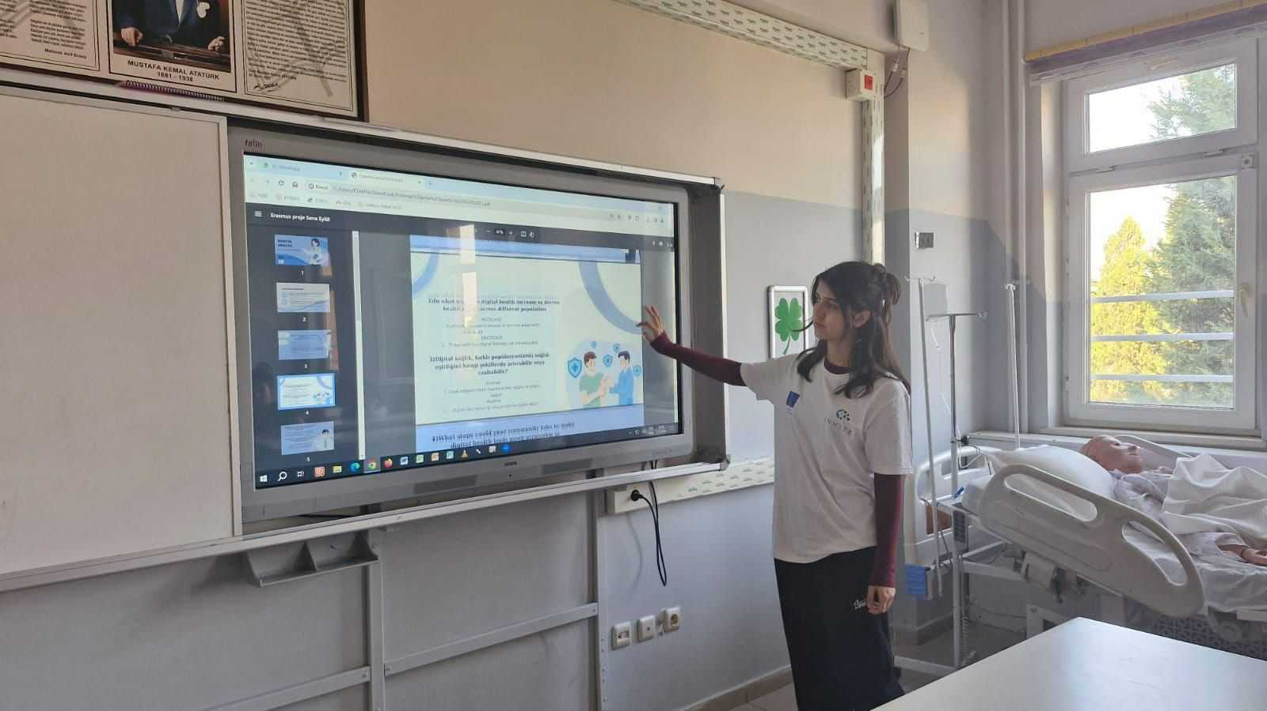
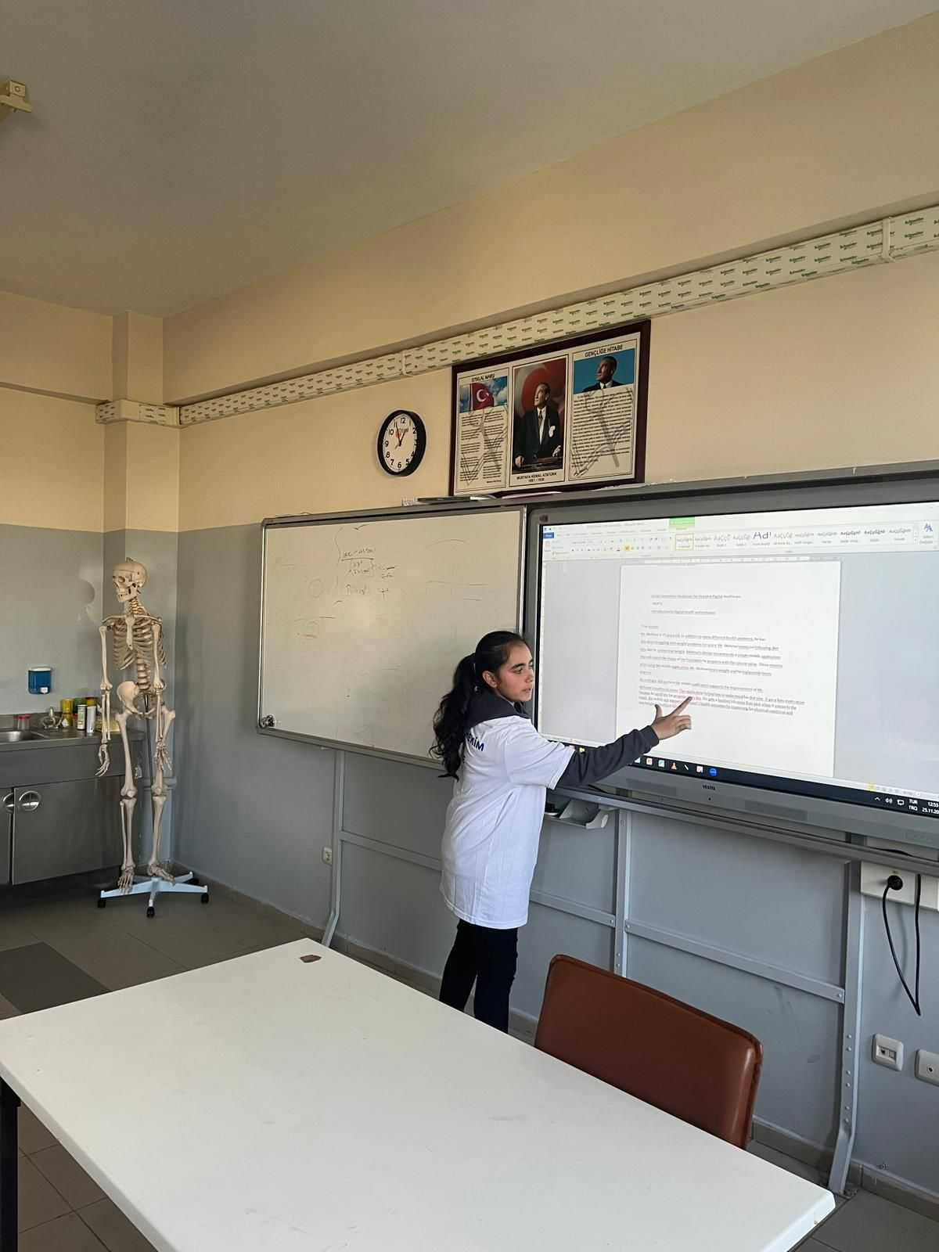
Modul 1 Digital Health Inclusion and the Needs of Older People and Vulnerable Groups
Special attention was given to understanding the needs of older adults, developing empathy, and designing inclusive digital health solutions. Students also gained hands-on experience with telehealth platforms and mHealth tools while learning strategies to support older adults in adopting digital technologies for better health management.

Slide 4
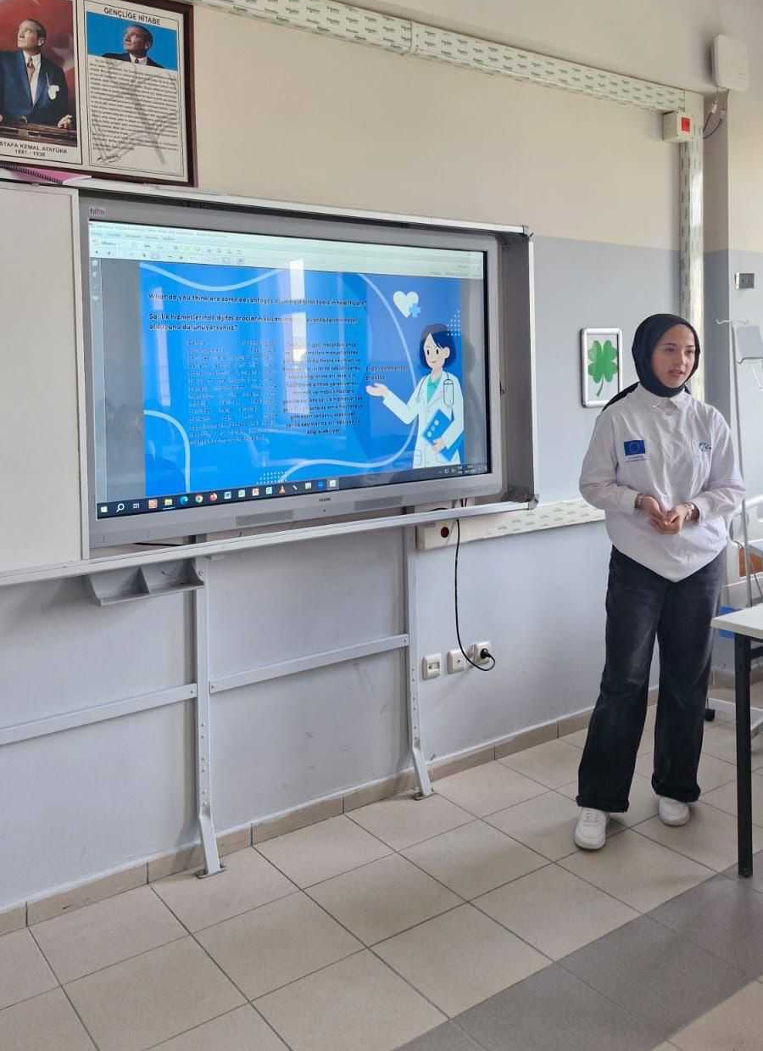
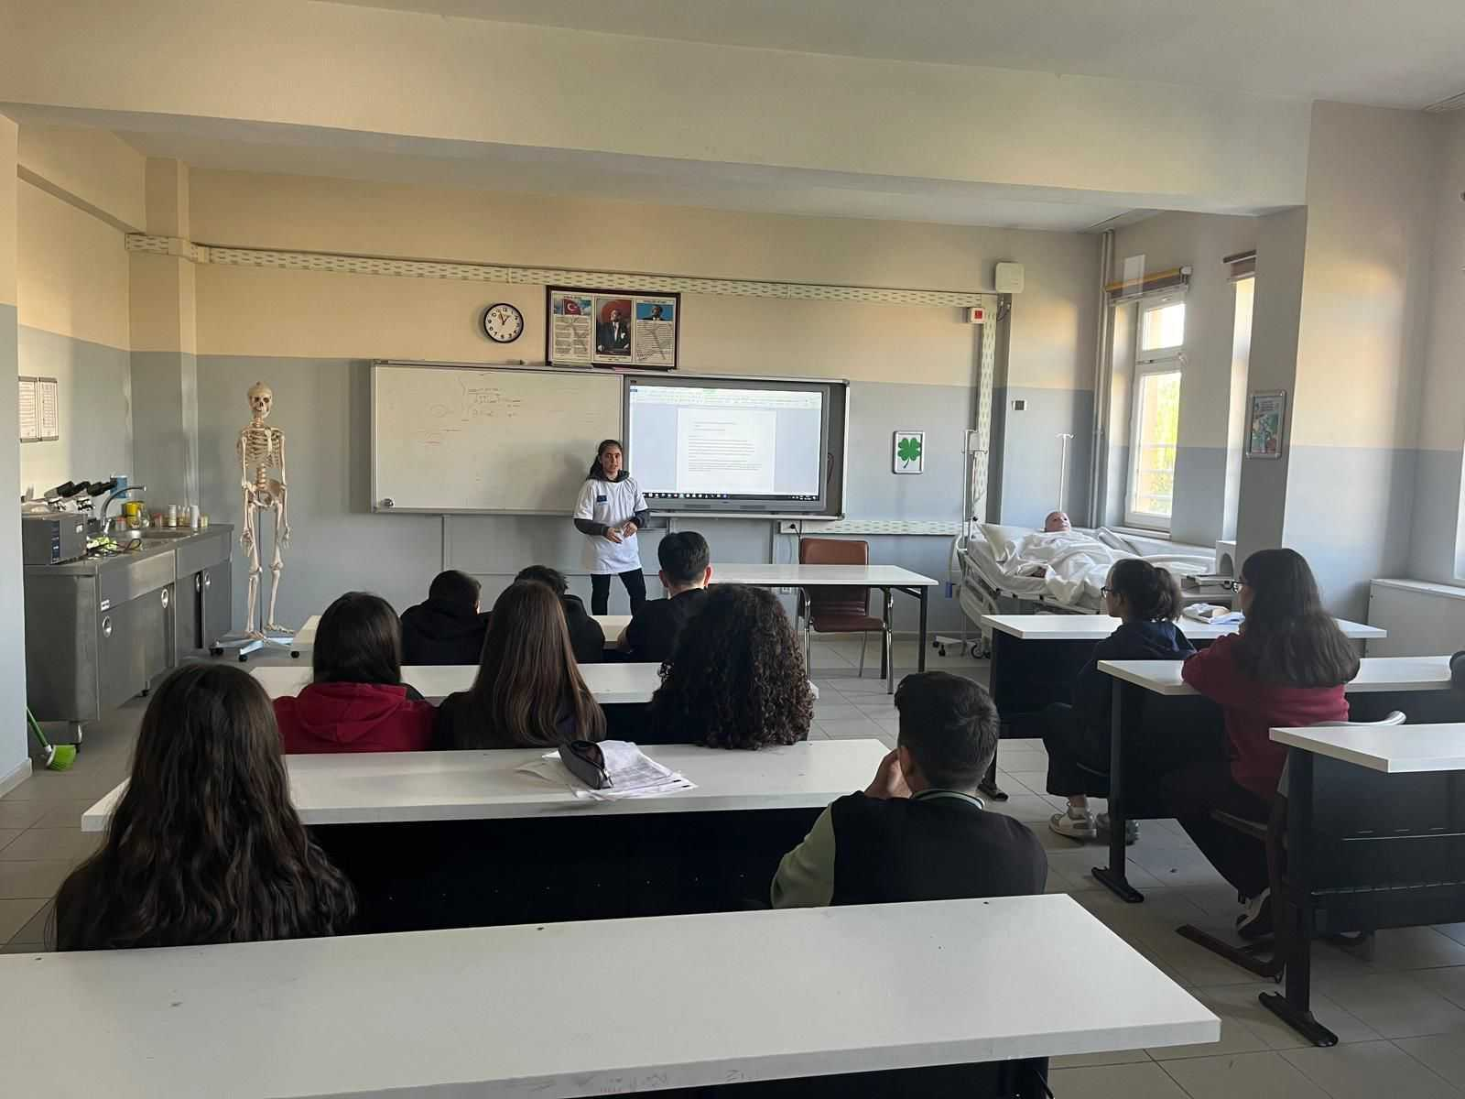
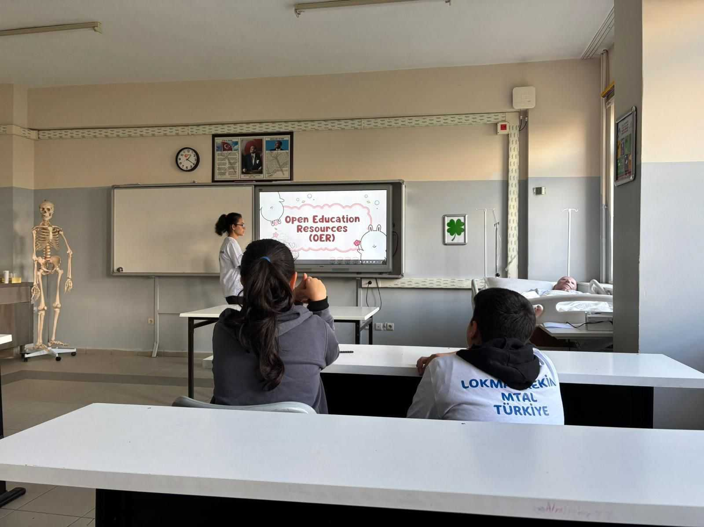
Modul 1 Digital Health Inclusion and the Needs of Older People and Vulnerable Groups

Slide 5
Modul 2 in Progress: Developing Practical Digital Health Skills
The implementation of Module 2 is currently underway, focusing on strengthening students’ practical skills in digital healthcare and improving the accessibility of digital health services for older adults and other vulnerable groups.
During the module, students are exploring the use of wearable devices, patient monitoring systems, and mobile health (mHealth) applications that support better health management and patient outcomes.
Working in teams, they are also identifying digital support systems and resources that help users engage more effectively with health technologies.

Slide 6
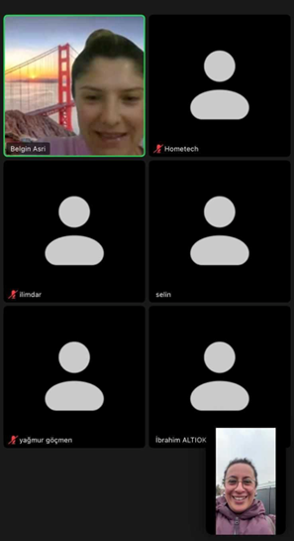
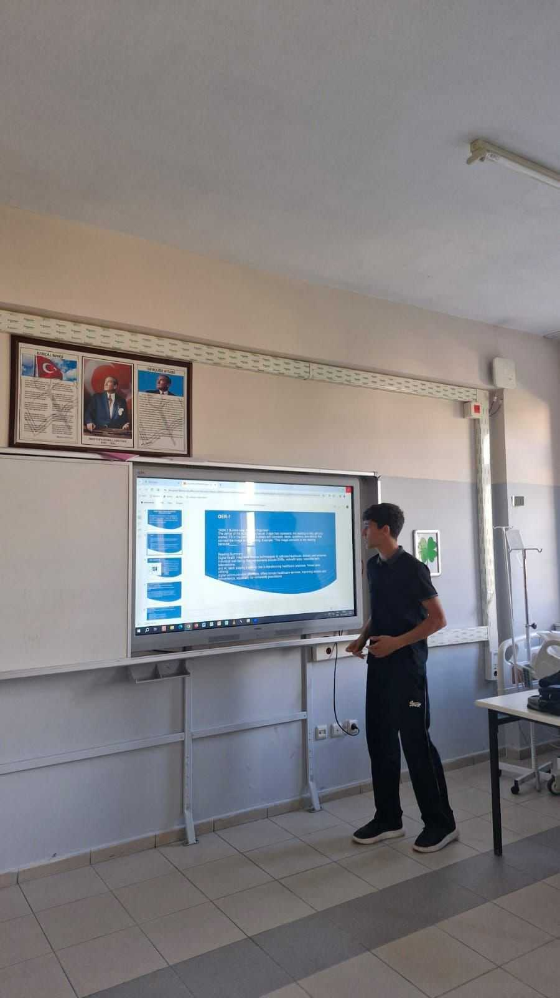
Modul 2 in Progress: Developing Practical Digital Health Skills
Through design thinking and collaborative learning, students are developing innovative ideas to improve digital health inclusion. As part of the module, they are also participating in a social incubator, where they design practical solutions aimed at enhancing the quality of life and digital inclusion of older adults.

Slide 7
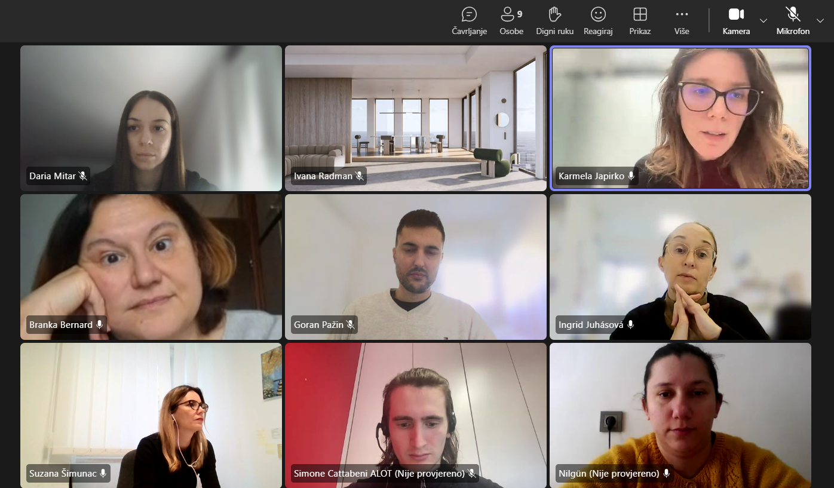
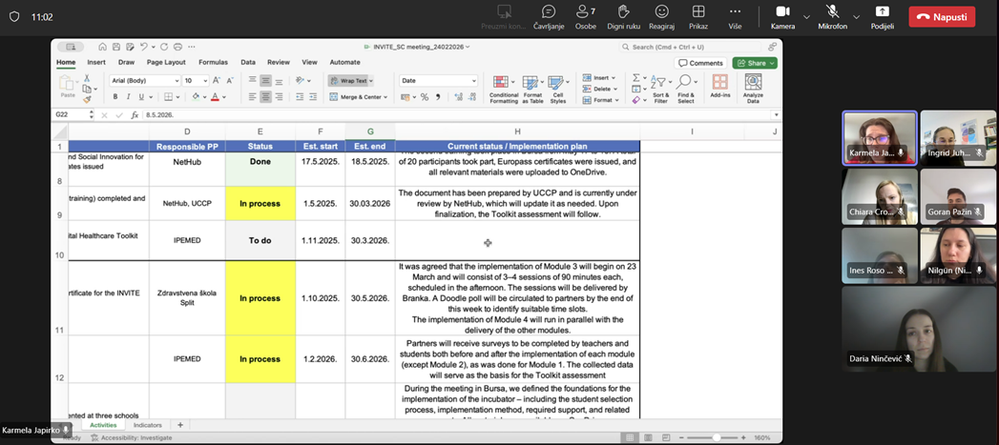
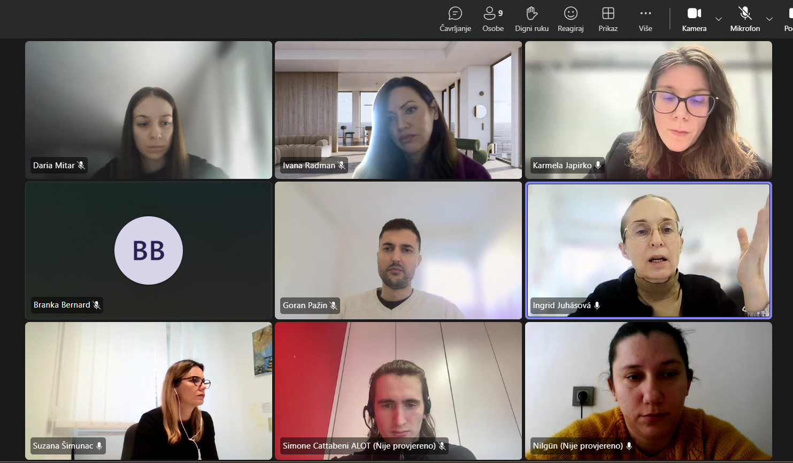
Steering committee meetings
The INVITE project continues to make steady progress thanks to regular steering committee meetings that bring project partners together to coordinate activities and monitor developments. These meetings provide an important opportunity for the team to review recent updates, evaluate progress across different work packages, and ensure that project activities remain aligned with the overall objectives.

Slide 8
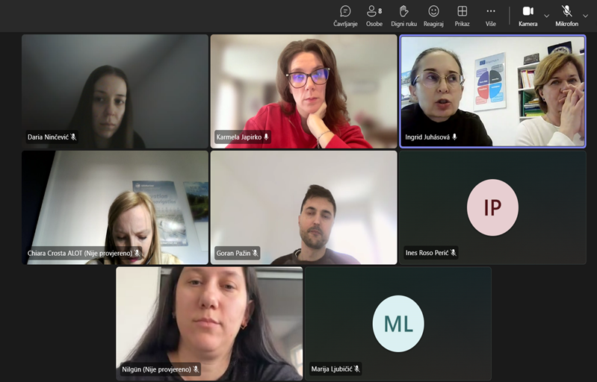
Steering committee meetings
During the meetings, partners discuss ongoing tasks, address any challenges that arise, and work collaboratively to identify practical solutions. The steering committee also plays a key role in making strategic decisions and planning the next steps of the project.
Through continuous communication, collaboration, and shared commitment among partners, the INVITE project is successfully moving forward and steadily achieving its key milestones and planned outcomes.

Slide 9
eTwinning project
The eTwinning project project for implementation of Social Innovation Incubators at medical VET schools is officially underway (started on February 1st), preparatory activities have begun. It was agreed that individual activities should take place by the end of March, joint activities within the school by the end of April, and activities in which all schools will participate by the end of May.

Slide 10
Upcoming events
Third project conference – March 2026
Fourth project conference – June 2026
Fifth project conference – September 2026
Learning expedition – September 2026

Slide 11

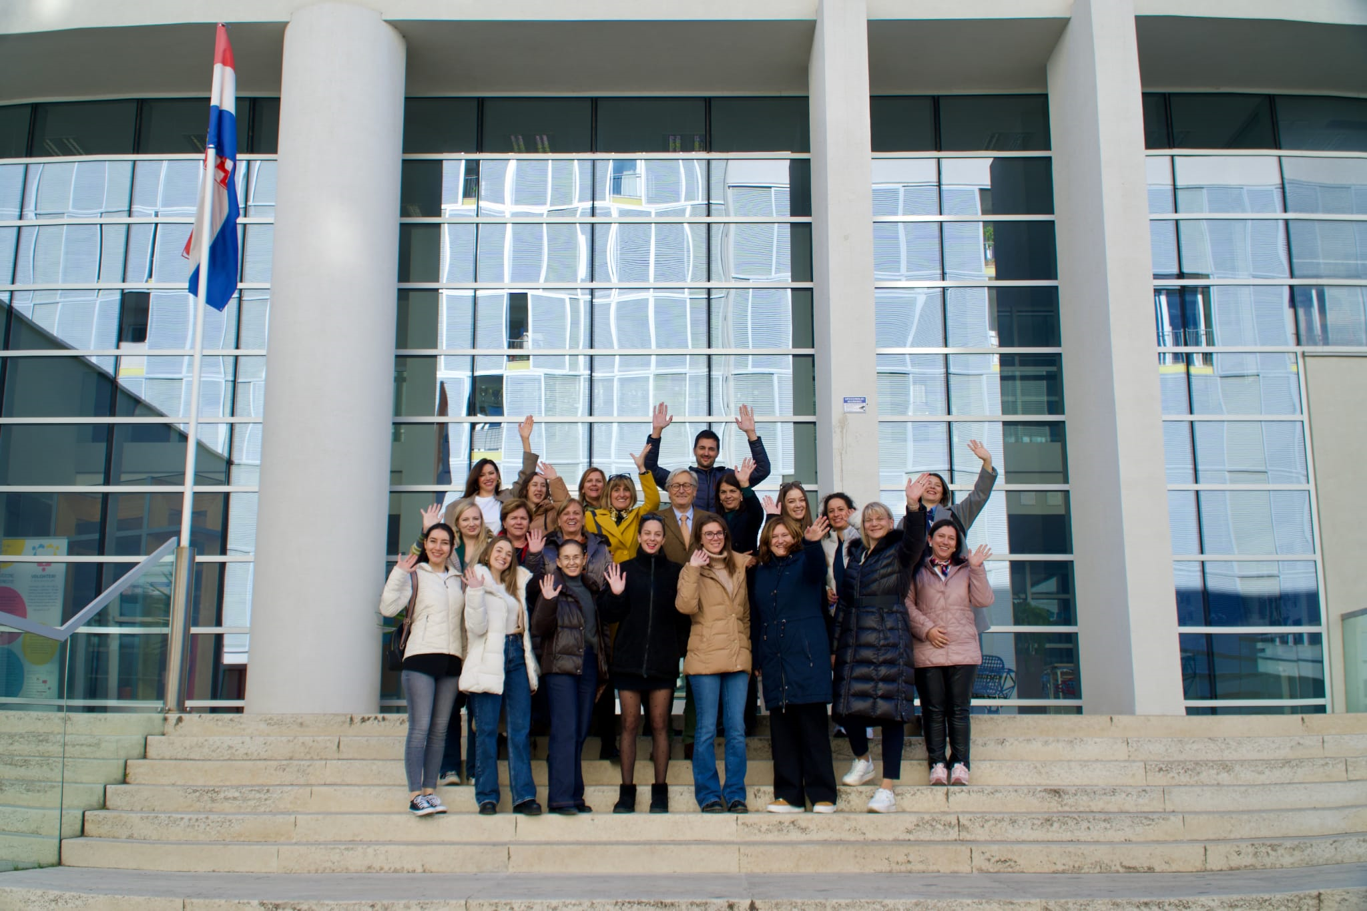
INVITE your future

